Slide 1
EMPLOYEE PERFORMANCE
DATA UNDERSTANDING ON EMPLOYEE PERFORMANCE

Slide 2
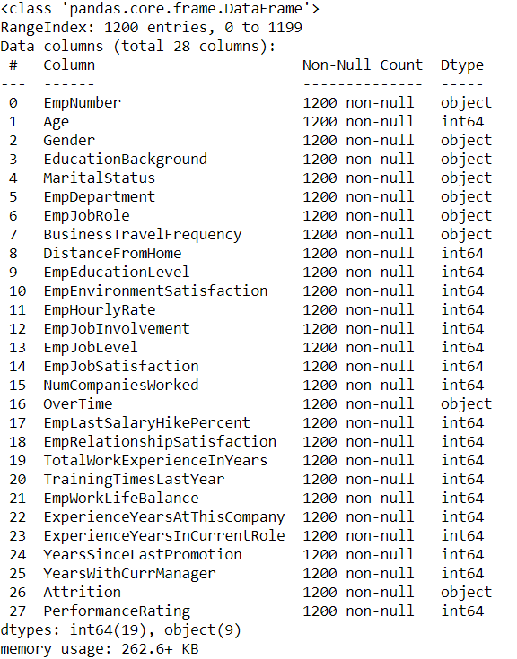
Data has no MISSING values

Slide 3
Column Name Description
EmpNumber The Employee Id
Age Age of the Employee
Gender Gender of the Employee
EducationBackground Education of the Employee
MaritalStatus Whether the Employee is Married, Unmarried or Single
EmpDepartment Employee is from which department
EmpJobRole The Job Role of the Employee
BusinessTravelFrequency How frequently the Employee travels for business
DistanceFromHome How far the Employee resides from the office
EmpEducationLevel What the level of education of the Employee
EmpEnvironmentSatisfaction How satisfied is Employee with the office/job environment
EmpHourlyRate How much Employee gets paid per hour
EmpJobInvolvement What is the job involvement level of the Employee
EmpJobLevel What is the Employee job level
EmpJobSatisfaction How satisfied the Employee is from the current job
NumCompaniesWorked How many companies has the Employee worked with
OverTime Whether Employees does overtime?
EmpLastSalaryHikePercent How much percent salary hike did Employee receive last time
EmpRelationshipSatisfaction How satisfied employee is with other Employees
TotalWorkExperienceInYears Total experience of the Employee in years
TrainingTimesLastYear How many trainings were conducted for the Employee last year
EmpWorkLifeBalance Level of Employee work life balance
ExperienceYearsAtThisCompany Experience with the current company in years
ExperienceYearsInCurrentRole Experience in current job role
YearsSinceLastPromotion How many years it has been without promotion
YearsWithCurrManager Number of years under current manager
Attrition Whether the Employee leave or will be removed
PerformanceRating The rating of the performance of Employee

Slide 4
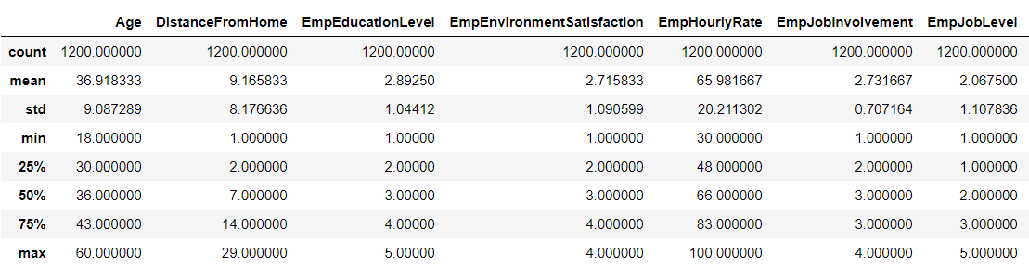
DIFFERENCE BETWEEN MEAN AND 50% OF DATA INDICATES THE PRESENCE OF SKEWNESS

Slide 5
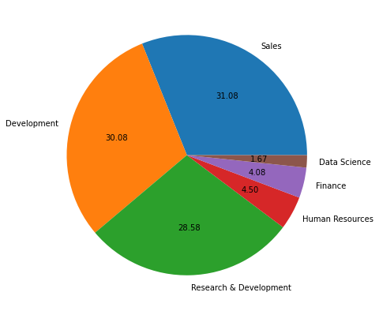
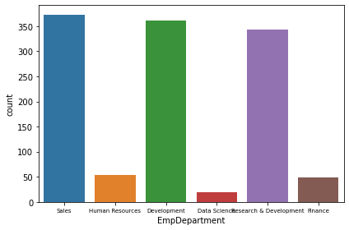
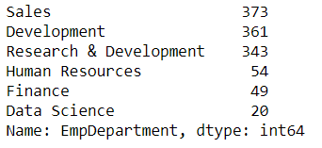
EMPLOYEE DEPARTMENT
- MOST OF THE EMPLOYEES ARE FROM 3 DEPARTMENTS
- SALES
- DEVELOPMENT
- RESEARCH & DEVELOPMENT

Slide 6
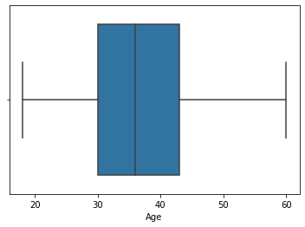
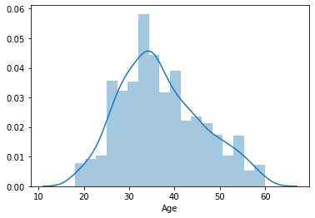
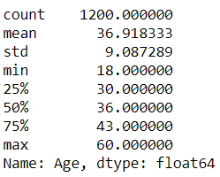
- THE MAX AGE OF THE EMPLOYEE IS 60 AND MIN AGE IS 18 yrs - THE AVERAGE AGE OF THE EMPLOYEE IS 36.91
AGE

Slide 7
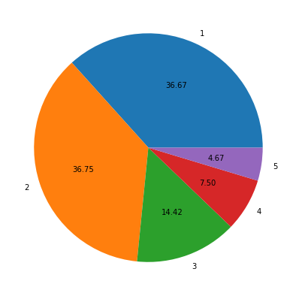
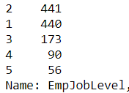
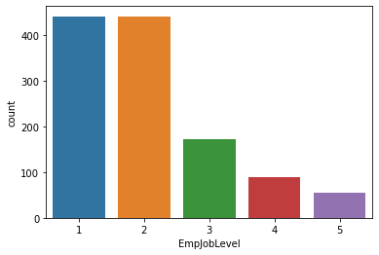
EMPLOYEE JOB LEVEL
JOB LEVEL
- THE EMPLOYEES ARE MORE FROM JOB LEVEL 1 & 2
- THE EMPLOYEES FROM LEVEL 4 & 5 ARE ON LESS

Slide 8
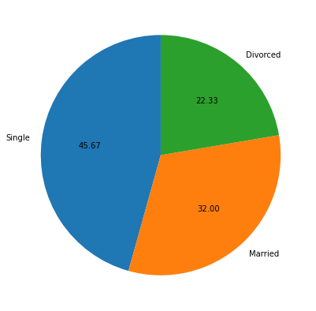
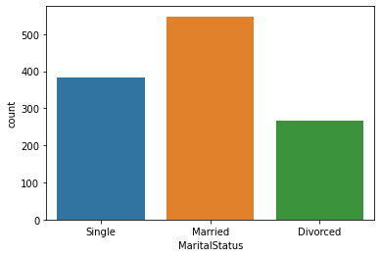

MARITAL STATUS
- 548 EMPLOYEES ARE MARRIED
- 384 EMPPLOYEES ARE SINGLE
- 268 EMPLOYEES ARE DIVORCED

Slide 9
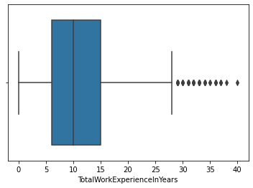
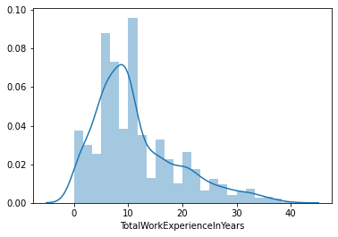
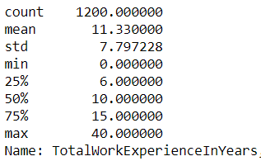
TOTAL WORK EXPERIENCE
- THE AVERAGE EXPERIENCE IS 11.33 yrs
- THE MAX TOTAL EXPERIENCE IS 40 yrs
- MOST OF THE EMPLOYEES EXPERIENCE LIE BETWEEN 6 AND 15 yrs
- THE TOTAL EXPERIENCE HAS OUTLIERS WHICH HAS TO BE INVESTIGATED

Slide 10
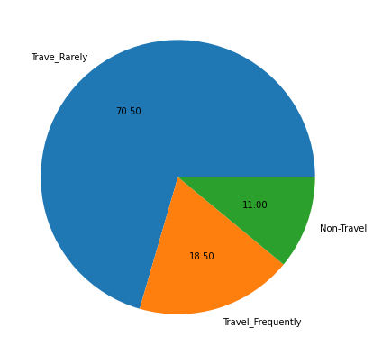
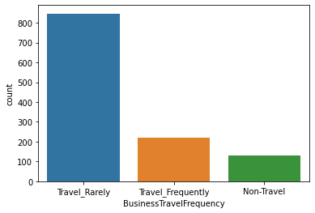

BUSINESS TRAVEL FREQUENCY
- MOST OF THE EMPLOYEES TRAVEL VERY RARELY
- VERY LESS EMPLOYEES DO NOT TRAVEL
- 222 EMPLOYEES TRAVEL VERY FREQUENTLY

Slide 11
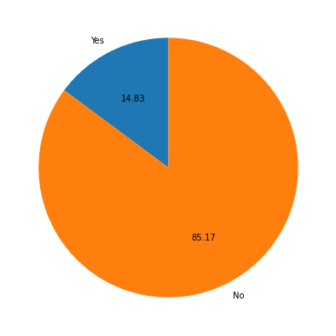
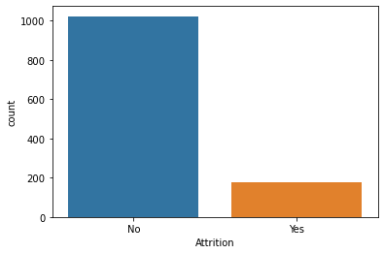

ATTRITION - THE IS NO ATTRITION FOR MOST OF THE EMPLOYEES - THERE IS ATTRITION FOR ONLY 178 EMPLOYEES

Slide 12
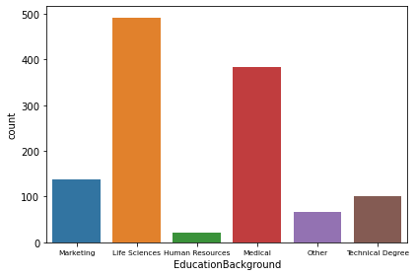
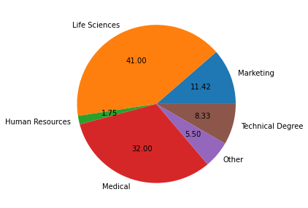
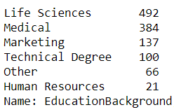
EDUCATION BACKGROUND - MAJORITY OF EMPLOYESS ARE FROM LIFE SICIENCE AND MEDICAL EDUCATION BACKGROUND

Slide 13
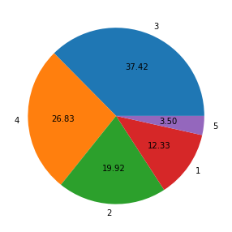
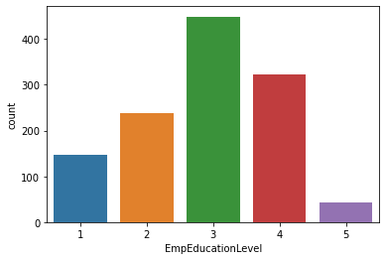
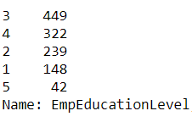
EMPLOYEE EDUCATION LEVEL
MOJORITY OF EMPLOYEES HAS EDUCATION LEVEL GREATER THAN 2

Slide 14
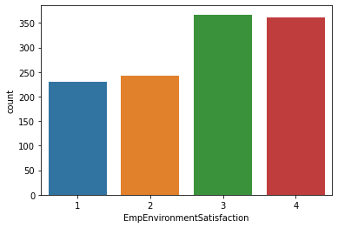
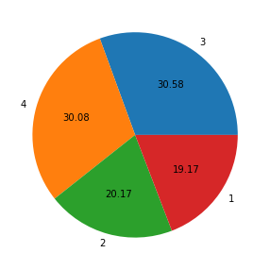
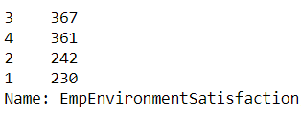
EMPLOYEE ENVIRONMENT SATISFACTION
MOST EMPLOYEES ARE NOT SATISFIED WITH THE WORK ENVIRONMENT
REASONS FOR DISSATISFACTION HAS TO INVESTICATED AND CAN NOT BE ANALYED THROUGH GIVEN DATA

Slide 15
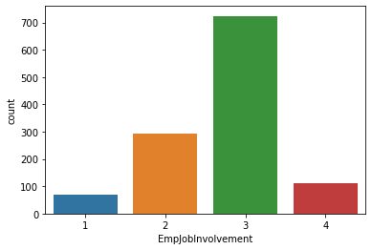
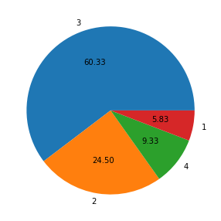
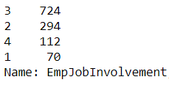
EMPLOYEE JOB INVOLVEMENT
MOJORITY OF EMPLOYEES HAVE HIGHER JOB INVOLVEMENT

Slide 16
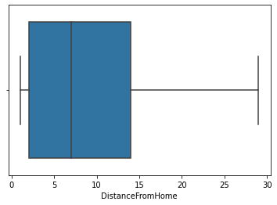
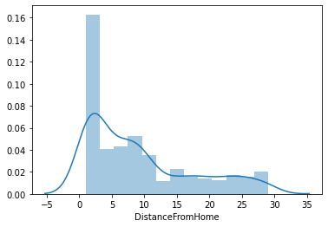
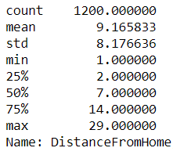
DISTANCE FROM HOME
MAJORITY OF EMPLOYEES STAY WITHIN THE DISTANCE OF 2 TO 14 KMS FROM THE OFFICE

Slide 17
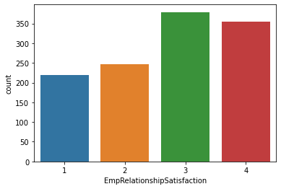
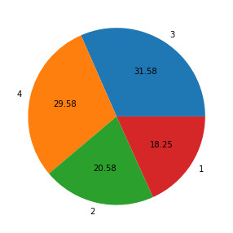
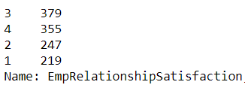
EMPLOYEE RELATIONSHIP SATISFACTION
MAJORITY OF THE EMPLOYEES HAVE LOW RELATIONSHIP SATISFACTION
FACTORS IMPACTING THE EMPLOYEE RELATIONSHIP SATISFACTION HAS TO BE INVESTIGATED

Slide 18
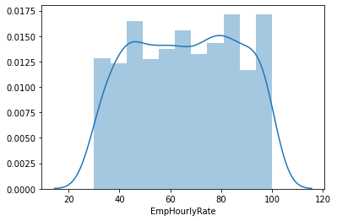
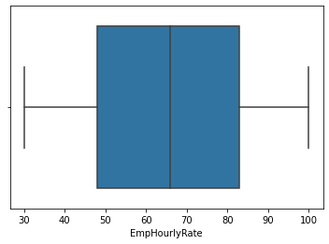
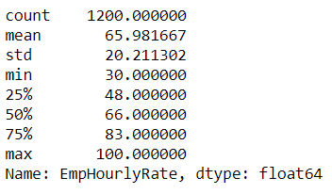
EMPLOYEE HOURLY RATE
MAJORITY OF THE EMPLOYEES EARN BETWEEN 48 TO 83 PER HOUR

Slide 19
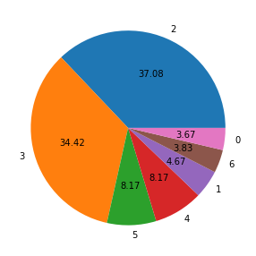
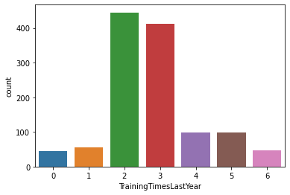
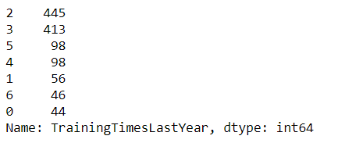
TRAINING TIMES LAST YEAR
HALF OF THE EMPLOYEES COUNT HAD MORE THAN 2 TRAININGS LAST YEAR

Slide 20
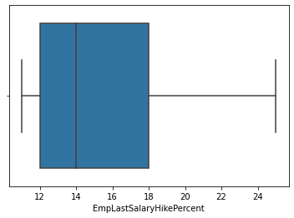
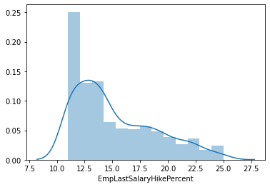
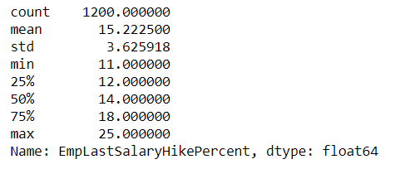
EMPLOYEE LAST SALARY HIKE PERCENT
MAJORITY OF EMPLOYEES GOT 12 TO 18 PERCENT HIKE LAST TIME WITH MAXIMUM BEING 25%

Slide 21
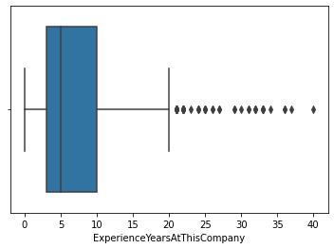
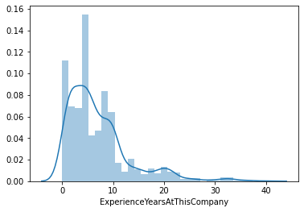
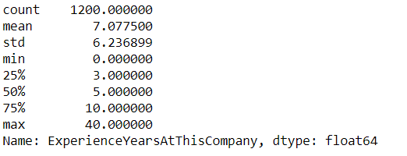
EXPERIENCE YEARS AT THIS COMPANY
MAJORITY OF EMPLOYEES EXPERIENCE IS BETWEEN 3 TO 10 YEARS
YEARS OF EXPERIENCE IN THIS COMPANY HAS MANY OUTLIERS

Slide 22



EMPLOYEE WORK LIFE BALANCE
SIGNIFICANT NUMBER OF EMPLOYEES HAVE WORK LIFE BALANCE OF LEVEL 3

Slide 23



YEARS SINCE LAST PROMOTION
MAJORITY OF EMPLOYEES WERE PROMOTED BETWEEN 0 TO 3 YEARS
OUTLIERS IN THE PROMOTION YEARS SIGNIFIES THAT MANY EMPLOYEES WERE NOT PROMOTED FOR MORE THAN 8 YEARS

Slide 24



PERFORMANCE RATING
- MAJORITY(72.83 %) OF THE EMPLOYEES WERE RATED 3
- REASONS IMPACTING THE PERFORMANCE HAS TO BE INVESTIGATED

Slide 25
EMPLOYEE PERFORMANCE ANALYSIS

Slide 26

Performance decreases with increase in the years since last promotion
Performance decreases with increase in years under same manager(Plot 2)
Performance decreases with increase in exp years in the same role
Employee performance increases with increase in work life balance(Plot 4)

Slide 27


YEARS SINCE LAST PROMOTION
Employee Rating decreases with increase in the Years since last promotion
Here promotion seems to be one of the major parameter impacting the performance of an employee

Slide 28


YEARS WITH CURRENT MANAGER
Employee Rating decreases with increase in years with current manager
Employees whose manager is changed in average 4 years perform very good

Slide 29

Num of Trainings VS Count of Trainings
The Performance Rating increases with increase in Trainings
Employees who received less number of trainings last year performs below average
37.08 % of employees undergone only 2 trainings last year

Slide 30

Employees with age 34 and 35 years are the low performers

Slide 31


Performance Rating Vs Age Vs Gender
Performance Rating Vs Age Vs Marital Status
Males have less Performance Rating compared to Females
Married Employees are have lowest Performance Rating when compared with Single and Divorced Emps

Slide 32

Department
VS
Performance Rating
- The Sales and Research & Development department has the highest number of low performers

Slide 33

Sales Executive, Sales Representative, Laboratory Technician, Research Scientist, Manager R & D, Finance Manager are the lowest performers
Employees with Sales Executives and Developer role are also the best performing employees

